Slide 1
LEO3 Product Information
2021.NOV

Slide 2


LEO3 Line-up
FY2020 |  | FY2021 |  | FY2022 |  | FY2023
Ⅰ | Ⅱ | Ⅰ | Ⅱ | Ⅰ | Ⅱ | Ⅰ | Ⅱ
8K e-shift
4K Native
4K e-shift
LEO3
€34,999
Oct €24,999
8K input, “e-shiftX”, 100mm lens
DLA-Z1E
LEO3 NZ9 (Laser)
€17,999
LEO H (DLA-NX9)
Oct €14,999
8K input, “e-shiftX”, 65mm lens
LEO3 NZ8 (Laser)
LEO
Oct €9,999
8K input, e-shift, 65mm lens
€7,999
LEO3 NZ7 (Laser)
LEO M (DLA-N7)
€5,999
LEO L (DLA-N5)
€3,499→€2,999 20/OCT
LX-NZ3
TBD

Slide 3
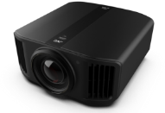


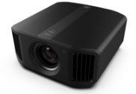
New Model Line-UP
8K60p/4K120p input with 8K/e-shiftX
0.69in 4K D-ILA
100mm High Resolution All Glass Lens
BLUEscent (Laser Light source) and new optics realizes 3,000lm Light Output
100,000:1 Native Contrast ∞:1 Dynamic Contrast
HDR(HDR10+/Frame Adapt HDR/HLG)
Wide Color Gamut (DCI cover)
isf ccc certification
NZ9/RS4100
8K60p/4K120p input with 8K/e-shiftX
0.69in 4K D-ILA
65mm High Resolution All Glass Lens
BLUEscent (Laser Light source) and new optics realizes 2,500lm Light Output
80,000:1 Native Contrast ∞:1 Dynamic Contrast
HDR(HDR10+/Frame Adapt HDR/HLG)
Wide Color Gamut (DCI cover)
isf ccc certification
NZ8/RS3100
8K60p/4K120p input with 8K/e-shift
0.69in 4K D-ILA
65mm High Resolution All Glass Lens
BLUEscent (Laser Light source) realizes 2,200lm Light Output
40,000:1 Native Contrast ∞:1 Dynamic Contrast
HDR(HDR10+/Frame Adapt HDR/HLG)
isf ccc certification
NZ7/RS2100

Slide 4
Catchphrase and Logo
Global Marketing Key Word (catch phrase)
Logo
About catch phrase:
We would like to focus “8K”, “LASER” and “HDR”, those are our main sales point for LEO3 models.
About Logo:
We are checking LOGO design with legal department now. Please use this still as a sample.
8K.LASER.HDR. THE NEW ULTIMATE
*SAMPLE
*SAMPLE

Slide 5


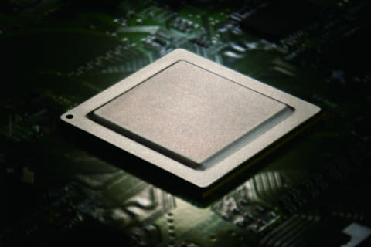
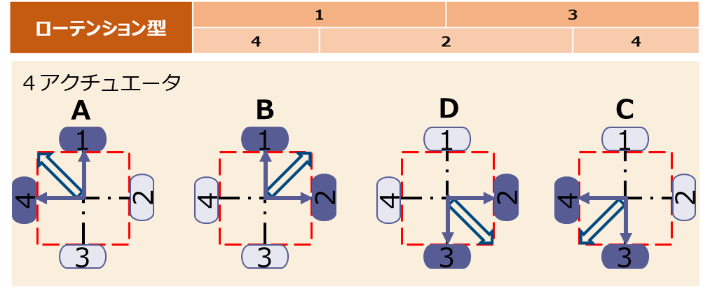
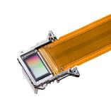



About 8K feature
8K
World first 8K input capable home theater projector.
Newly developed 8K/e-shiftX (4-way e-shift) realizes breath taking 8K high resolution
4K
2K
Newly equipped 8K circuit
8K/e-shiftX
High Speed Drive
D-ILA device
☆Image display using all 8K input information
*240hz drive
Image
Equipped with a newly adopted 8K compatible SOC chip to realize consistent 8K processing from input to panel.
8K original
e-shift
e-shiftX

Slide 6


About 8K feature
NZ9
NZ8
NZ7
Equipped with 4K120p input and low latency mode
4K120p Input
High-Frame Rate signals can be processed without any conversion, so it is possible to display smooth images without impairing the quality of the video itself.
Low Latency Mode
Extremely effective when displaying high frame rate gaming content, etc., which is expected to increase in the future.
Opens up new possibilities for high-quality gaming on large screens over 100 inches.

Slide 7
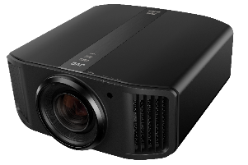
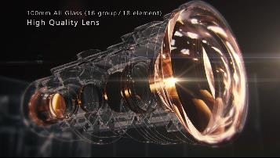
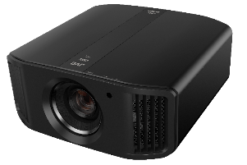
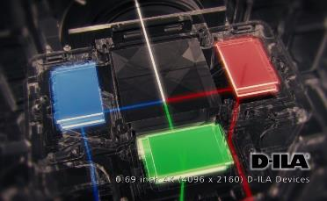
About 8K feature
Equipped with an all-glass lens which enable
8K information in the entire lineup
NZ9
100mm diameter
18-element, 16 groups
100% vertical, 43% horizontal shift range
NZ8
65mm diameter
17-element, 15 groups
80% vertical, 34% horizontal shift range
NZ7
“Ultra High Clarity Optics” (naming TBA)
NZ9
NZ8
・3,000lm brightness realized in such compact housing
Increased light output by improving the prism polarization method achieving an output increase of approximately 10%.
・Additional optical device removes
unnecessary internal light.

Slide 8
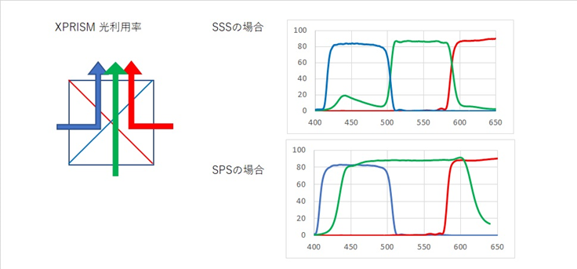
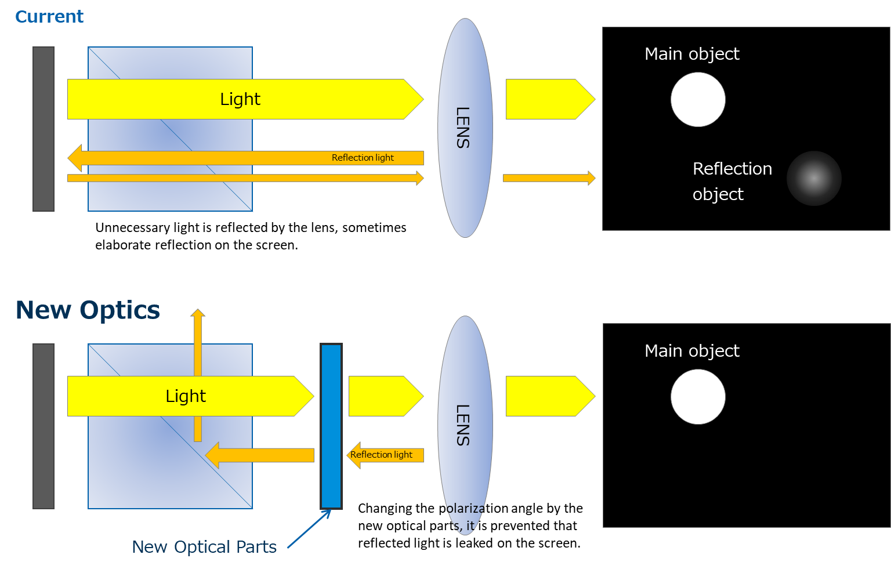
About Ultra High Clarity Optics
*Tentative name
Image
Realize High brightness of 3,000lm
New optical device thoroughly removes unnecessary internal light.
①New Prism（SPS)
②New optical parts（Ghost Buster）
Compared to the conventional method, the G (green) component that contributes to optical brightness can be used more, achieving an output increase of about 10%.
Achieves ANSI contrast that is approximately twice that of conventional products by suppressing internal reflection of the optical system.

Slide 9
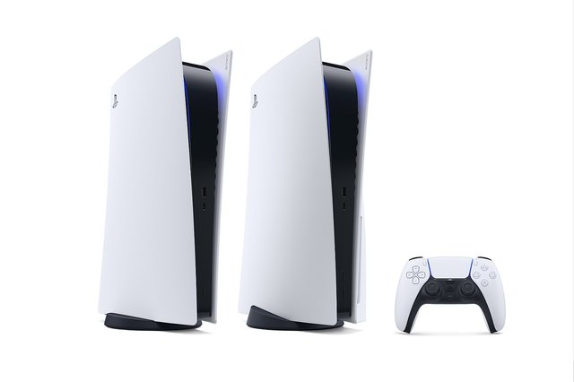
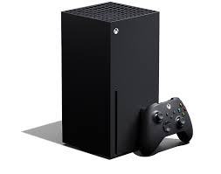
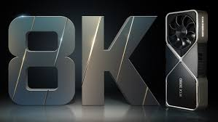
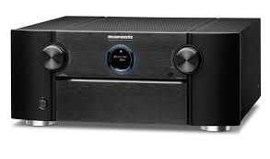
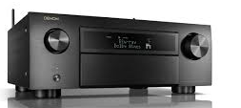
About 8K feature
*Reference：8K compatible products (support HDMI2.1) as of Jan. 2021
【Products】
Gaming console：
Brand | Model | 4K120p | 8K60p | Description
SONY | PS5 | ✓ | * | *Not supported at this time. Corresponding with future firmware upgrade
Microsoft | Xbox Series X | ✓ | * | *Not supported at this time. Corresponding with future firmware upgrade。
Graphic Board:
Brand | Model | 4K120p | 8K60p | Description
Nvidia | GEFORCE RTX 3060 Ti | ✓ | ✓ | HDMI2.1+DSC Max 8K 12 bit HDR @ 60Hz
 | GEFORCE RTX 3070 | ✓ | ✓ | HDMI2.1+DSC Max 8K 12 bit HDR @ 60Hz
 | GEFORCE RTX 3080 | ✓ | ✓ | HDMI2.1+DSC Max 8K 12 bit HDR @ 60Hz
 | GEFORCE RTX 3090 | ✓ | ✓ | HDMI2.1+DSC Max 8K 12 bit HDR @ 60Hz
AV Receiver：
Brand | Model | 4K120p | 8K60p | Description
Denon | AVR-X2700H | ✓ | ✓ | Input HDMI 6 and output Monitor 1,2 are support 8K signal
 | AVR-X4700H | ✓ | ✓ | Input HDMI 7 and output Monitor 1,2 are support 8K signal
 | AVC-X6700H | ✓ | ✓
Marantz | NR-1711 | ✓ | ✓ | Input HDMI 6 and output Monitor 1,2 are support 8K signal
 | SR-6015 | ✓ | ✓ | Input HDMI 7 and output Monitor 1,2 are support 8K signal
 | SR-8015 | ✓ | ✓
Yamaha | RX-V4A | * | * | Only 8K60B(DSC signal)pass through.4K/120Hz(4K120AB)will be supporting by firmware update.
 | RX-V6A | * | *

Slide 10

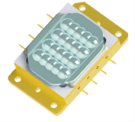
About BLU-Escent
Model | Light Source | Brightness
NZ9 | BLU-Escent | 3,000lm
NZ8 | BLU-Escent | 2,500lm
NZ7 | BLU-Escent | 2,200lm
JVC Original Laser Light Source technology
Realize High Brightness of 3,000lm
Compatible with large screens of over 200 inches
Significantly increase the peak brightness for HDR projection
20,000 hours long life
Over 20 years of watching 2.5 hours of movies every day
High power laser diode package
Dynamic light source control
Reduced the laser unit size significantly, while achieving a high brightness of 3,000lm
Light output can be controlled instantly without delay accordingly to the scene’s brightness
Creates images close to human perception
Enable contrast ratio of ∞:1 by controlling the output of the laser during Hide or signal recognition
image

Slide 11
About JVC Unique D-ILA Device
NZ9
NZ8
NZ7
Equipped with a new 0.69-inch native 4K "D-ILA" device that has improved drive performance
Improved to drive the panel twice as fast as before
Possible to display images at a high speed equivalent to 240hz
Realize “8K e-shift X”

Slide 12



About HDR
NZ9
NZ8
NZ7
Supports HDR (High Dynamic Range) that dramatically improves the expressiveness of images
The "HDR10 +" method that supports dynamic data is newly supported.
Two dynamic tone mapping
HDR Feature | Point
 | Add metadata to each scene with the intention of the creator Reproduce the image quality according to the director's intention
Frame Adapt HDR Theater Optimizer | Perform tone mapping according to the content input signal and installation environment / usage conditions Reproduce the best image processing technology that JVC can currently have

Slide 13







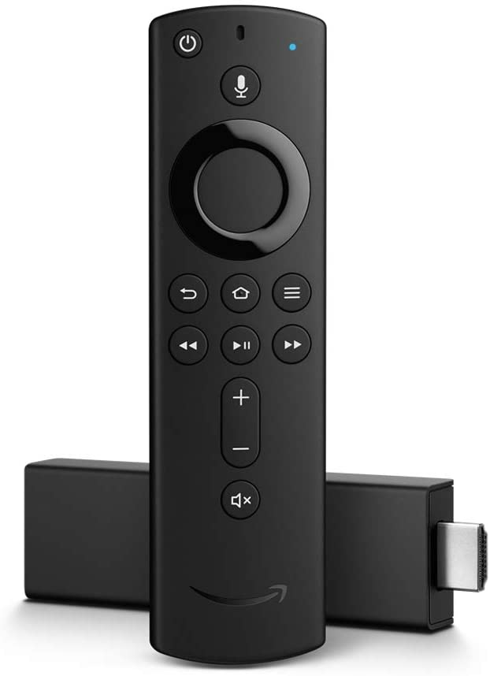
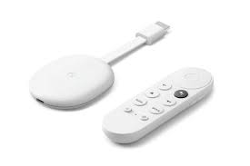
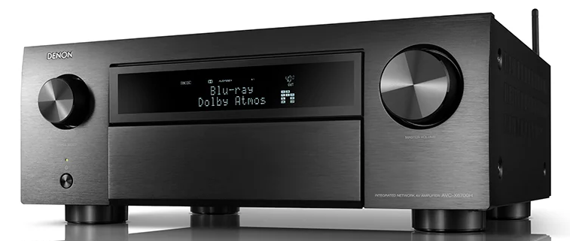
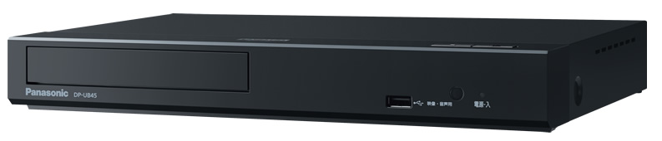
About HDR
HDR10+：Content and Support devices
【Studios】
*More than 200 movies support HDR10+
【Released UHD-BD】
【OTT provider】
Studio | #
UNIVERSAL | 14
WB | 6
Fox | 10
IMAX | 2
Shout Factory | 2
Lions Gate | 1
Vicom | 1
Service | Number | Comment
Amazon Prime | More than 50 series 500 episodes | All UHD content support HDR10+
Google Play Movie | 26 titles *at Japan 1/13 | Start from 2020/Q3
Rakuten | No info | Europe Rakuten TV
Megogo | More than 170 titles | Russia OTT
Youtube | No info | Support HDR10+ format
【Main Device】
Chromecast
with Google TV
Denon & Marantz
AV Receiver
Panasonic UHD-BDP
Fire TV Stick 4K
*About 40 titles

Slide 14


Video processing technology
NZ9
NZ8
NZ7
Improved accuracy of our original "Clear Motion Drive"
Reviewed the interpolation algorithm
Improved the motion compensation accuracy at the object boundary
Combining with "Motion Enhance" that optimizes the drive of the "D-ILA" device according to the movement of the image, the image can be reproduced more smoothly.
Clear Motion Drive OFF
Clear Motion Drive ON
* Cannot be used when inputting 4K120p or 8K signal.

Slide 15
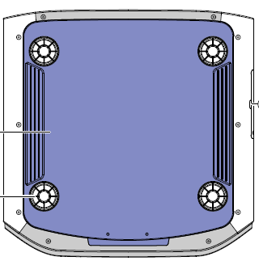

Functions that realize highly flexible installation
Intake / exhaust layout / footprint with ease of installation
NZ9
NZ8
NZ7
Adopted rear intake / front exhaust layout that flexibly supports various installation methods
At the bottom of the body, a foot point corresponding to the position of the conventional ceiling mount is provided, and it can be replaced without purchasing a new bracket.
Exhaust 55 ° outward to the main body to prevent heat haze on the screen.
A non-slip is placed on the bottom to prevent slipping when installing the main body.

Slide 16
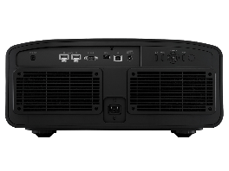
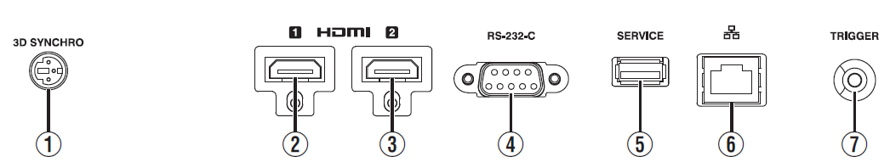
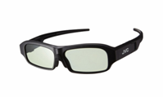
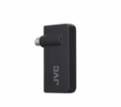
Terminals / Options
Terminals
3D Emitter
2 x HDMI
RS232C
*for control
USB
*Firmware Update
RJ45(LAN)
*for control
12V Trigger
Options
PK-AG3 RF 3D glasses
PK-EM2 RF 3D emitter
Full recharge 2.5hours/work 100hours
USB-Mini USB cable included
Signal reaches 10m
No interruption to other equipment with IR signal
No limitation for the number of the glasses

Slide 17
4. Function and Spec Sheet

Slide 18
Main Functions
 | ZH(NZ9) | ZM(NZ8) | ZL(NZ7)
8K/e-shiftX(4way) | ● | ● | -
8K/e-shift(2way) | - | - | ●
8K60Pinput | ● | ● | ●
4K120Pinput | ● | ● | ●
100mm Lens | ● | - | -
65mm Lens | - | ● | ●
BLUEscent(Laser) | ● | ● | ●
Ultra High Clarity Optics | ● | ● | -
Cinema filter（DCI P3） | ● | ● | -
HDR10+compatible | ● | ● | ●
Frame Adapt HDR | ● | ● | ●
Theater Optimizer | ● | ● | ●
3D compatible | ● | ● | ●
MPC | ● | ● | ●
C.M.D. | ● | ● | ●
Low latency mode | ● | ● | ●
Auto calibration | ● | ● | ●
Installation setting mode | ● | ● | ●
Isf compatible | ● | ● | ●

Slide 19
Spec
 | ZH(NZ9) | ZM(NZ8) | ZL(NZ7)
R/P | €24,999 | €14,999 | €9,999
Release | Oct. 2021
Device | 0.69” 4K D-ILA x3
Resolution | 8,192 x 4,320 (8K/e-shiftX *4-Way) |  | 8,192 x 4,320 (8K/e-shift)
Light Source | Laser Phosphor
Lens | All Glass (100mm) | All Glass (65mm)
Brightness | 3,000lm | 2,500lm | 2,200lm
Contrast | 100,000:1 | 80,000:1 | 40,000:1
Color Gamut | DCI/BT.2020 74% |  | sRGB
Optical unit | ✓ Enhanced Optics（SPS, Ghost Buster) |  | - Standard Optics（SSS)
HDMI | HDMI2.1/HDCP2.3 x2 *48Gbps
Max input | 8K60p/4K120p
MEMC(C.M.D) | ✓ *Not support 4K120hz
HDR | Yes (HDR10/HLG) *Frame Adapt HDR, Theater Optimizer, HDR10+
Filmmaker Mode | ✓*Future firmware update
isf | ✓
Size（WxHxD mm) | 500 x 215 x 538 | 500 x 215 x 515
Weight (Kg) | 25kg（TBD） | 25kg（TBD） | 25㎏（TBD）

